Slide 1
Python Pandas Datasets

Slide 2
PYTHON PANDAS FUNCTION APPLICATIONS
To apply your own or another library’s functions to Pandas objects, you should be aware of the three important methods. The methods have been discussed below.
The appropriate method to use depends on whether your function expects to operate on an entire DataFrame, row- or column-wise, or element wise.
Table wise Function Application: pipe()
Row or Column Wise Function Application: apply()
Element wise Function Application: applymap()

Slide 3
Table-wise Function Application
Custom operations can be performed by passing the function and the appropriate number of parameters as pipe arguments. Thus, operation is performed on the whole DataFrame.

Slide 4
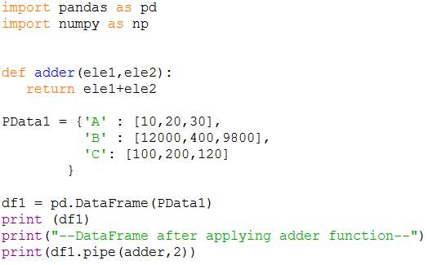
Example, add a value 2 to all the elements in the DataFrame.

Slide 5
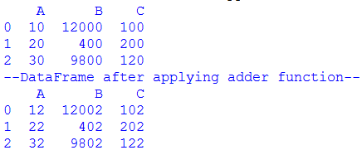

Slide 6
Row or Column Wise
Function Application
Arbitrary functions can be applied along the axes of a DataFrame or Panel using the apply() method, which, like the descriptive statistics methods, takes an optional axis argument. By default, the operation performs column wise, taking each column as an array-like.

Slide 7
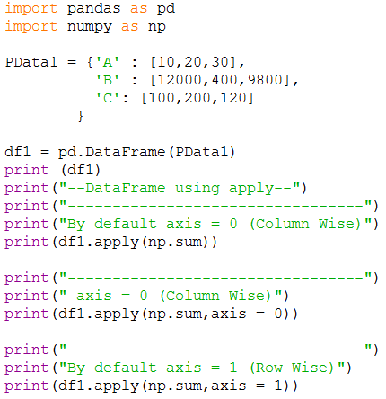

Slide 8
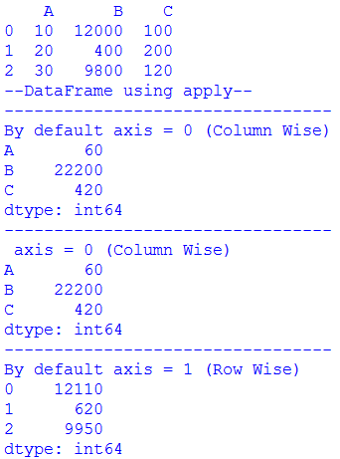

Slide 9
Example
import pandas as pd
import numpy as np
PData1 = {'A' : [10,20,30],
'B' : [12000,400,9800],
'C': [100,200,120]
}
df = pd.DataFrame(PData1)
print(df)
print("----------------------------")
print(df.apply(lambda x: x.max() - x.min()))
print("---Mean---------------------")
print (df.apply(np.mean))

Slide 10
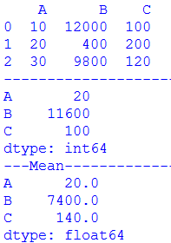

Slide 11
Element Wise Function Application
Not all functions can be vectorized (neither the NumPy arrays which return another array nor any value), the methods applymap() on DataFrame and analogously map() on Series accept any Python function taking a single value and returning a single value.

Slide 12
Example
import pandas as pd
import numpy as np
PData1 = {'A' : [10,20,30],
'B' : [12000,400,9800],
'C': [100,200,120]
}
df = pd.DataFrame(PData1)
print(df)
# My custom function
print("----After use of map ----")
print(df['A'].map(lambda x:x*100))
print("---------Mean-------------")
print (df.apply(np.mean))

Slide 13
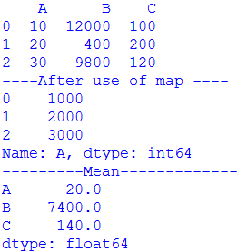

Slide 14
Example – applymap
import pandas as pd
import numpy as np
PData1 = {'A' : [10,20,30],
'B' : [12000,400,9800],
'C': [100,200,120]
}
df = pd.DataFrame(PData1)
print(df)
# My custom function
print("----After use of map ----")
print(df['A'].map(lambda x:x*100))
print("----After use of applymap ----")
#print(df['A'].applymap(lambda x:x*100)) # Error
print(df.applymap(lambda x:x*100))
print("---------Mean-------------")
print (df.apply(np.mean))

Slide 15
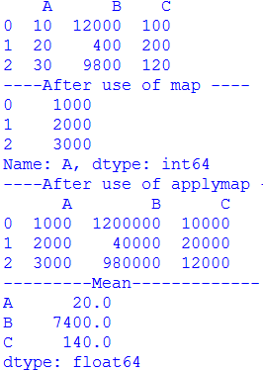

Slide 16
GROUP BY
Any groupby operation involves one of the following operations on the original object. They are −
Splitting the Object
Applying a function
Combining the results
In many situations, we split the data into sets and we apply some functionality on each subset.
In the apply functionality, we can perform the following operations −
Aggregation − computing a summary statistic
Transformation − perform some group-specific operation
Filtration − discarding the data with some condition

Slide 17
Split Data into Groups
Pandas object can be split into any of their objects. There are multiple ways to split an object like −
obj.groupby('key')
obj.groupby(['key1','key2'])
obj.groupby(key,axis=1)

Slide 18
Example
import pandas as pd
PData = {'Name' : ['Arpit','Zayana','Kareem','Abhilash','Dhanya','Siju','Ankita','Divya','Nidhin','Hari'],
'Age' : [62,18,68,26,24,23,16,20,25,28],
'Department' : ['Surgery','ENT','Orthopedic','Surgery','ENT','Cardiology','ENT','Cardiology','Orhopedic','Surgery'],
'Fee':[300,250,450,300,350,800,100,500,700,450],
'Gender':['M','F','M','M','F','M','F','F','M','M']
}
df = pd.DataFrame(PData)
print(df)
print("----groupby--------------")
print(df.groupby ('Department'))

Slide 19
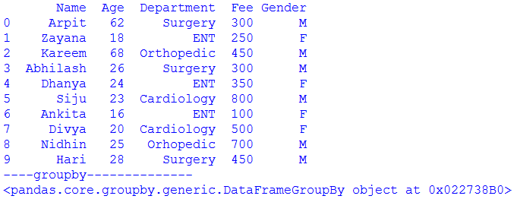

Slide 20
Example – View Groups
import pandas as pd
PData = {'Name' : ['Arpit','Zayana','Kareem','Abhilash','Dhanya','Siju','Ankita','Divya','Nidhin','Hari'],
'Age' : [62,18,68,26,24,23,16,20,25,28],
'Department' : ['Surgery','ENT','Orthopedic','Surgery','ENT','Cardiology','ENT','Cardiology','Orhopedic','Surgery'],
'Fee':[300,250,450,300,350,800,100,500,700,450],
'Gender':['M','F','M','M','F','M','F','F','M','M']
}
df = pd.DataFrame(PData)
print(df)
print("----View Groups--------------")
print(df.groupby ('Department').groups)

Slide 21
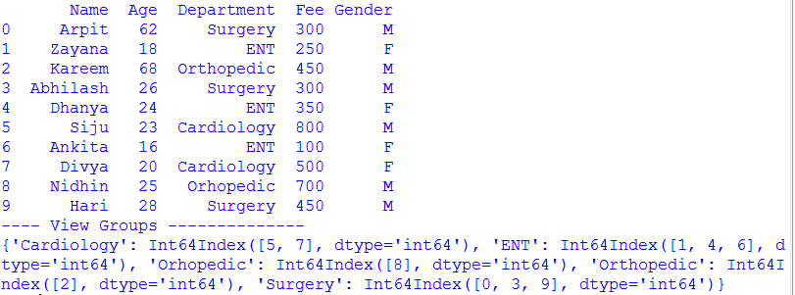

Slide 22
Example – Groupby with Multiple Columns
import pandas as pd
PData = {'Name' : ['Arpit','Zayana','Kareem','Abhilash','Dhanya','Siju','Ankita','Divya','Nidhin','Hari'],
'Age' : [62,18,68,26,24,23,16,20,25,28],
'Department' : ['Surgery','ENT','Orthopedic','Surgery','ENT','Cardiology','ENT','Cardiology','Orhopedic','Surgery'],
'Fee':[300,250,450,300,350,800,100,500,700,450],
'Gender':['M','F','M','M','F','M','F','F','M','M']
}
df = pd.DataFrame(PData)
print(df)
print("----Groupby with Multiple Columns---------")
print(df.groupby (['Department‘, ‘Gender’].groups)

Slide 23
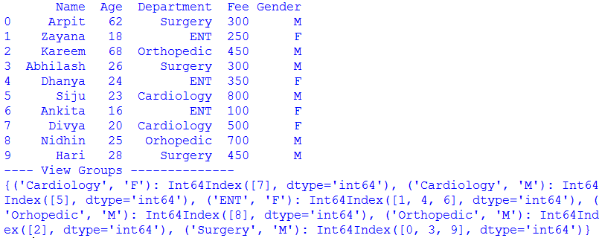

Slide 24
Example – Iterate Through Groups
import pandas as pd
PData = {'Name' : ['Arpit','Zayana','Kareem','Abhilash','Dhanya','Siju','Ankita','Divya','Nidhin','Hari'],
'Age' : [62,18,68,26,24,23,16,20,25,28],
'Department' : ['Surgery','ENT','Orthopedic','Surgery','ENT','Cardiology','ENT','Cardiology','Orhopedic','Surgery'],
'Fee':[300,250,450,300,350,800,100,500,700,450],
'Gender':['M','F','M','M','F','M','F','F','M','M']
}
df = pd.DataFrame(PData)
print("---- Iterate through Groups------------")
grouped = df.groupby ('Department')
for name,group in grouped:
print (name)
print (group)

Slide 25
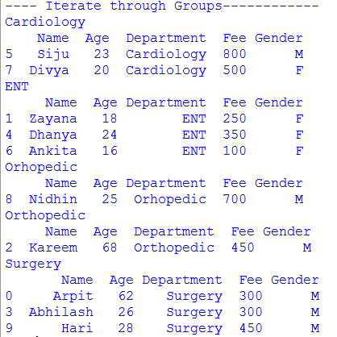

Slide 26
Example – Select a Single Group
import pandas as pd
PData = {'Name' : ['Arpit','Zayana','Kareem','Abhilash','Dhanya','Siju','Ankita','Divya','Nidhin','Hari'],
'Age' : [62,18,68,26,24,23,16,20,25,28],
'Department' : ['Surgery','ENT','Orthopedic','Surgery','ENT','Cardiology','ENT','Cardiology','Orhopedic','Surgery'],
'Fee':[300,250,450,300,350,800,100,500,700,450],
'Gender':['M','F','M','M','F','M','F','F','M','M']
}
df = pd.DataFrame(PData)
print("---- Select a Single Group------------")
grouped = df.groupby ('Department')
print (grouped.get_group('ENT'))

Slide 27


Slide 28
Aggregations
An aggregated function returns a single aggregated value for each group. Once the group by object is created, several aggregation operations can be performed on the grouped data.
An obvious one is aggregation via the aggregate or equivalent agg method.
print("---- Aggregation (agg or aggregate ) ---")
print("--Department wise sum of fee--")
grouped = df.groupby ('Department')
print (grouped['Fee'].agg(np.sum))
print("--Department wise Mean--")
print (grouped['Fee'].aggregate(np.mean))

Slide 29
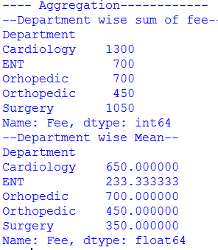

Slide 30
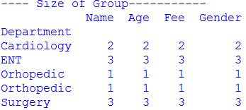
To find size of group
grouped = df.groupby ('Department')
print (grouped.aggregate(np.size))
OR
print (grouped.agg(np.size))
Output

Slide 31
Applying Multiple Aggregation Functions
grouped Series, you can also pass a list or dict of functions to do aggregation with, and generate DataFrame as output –
print("-Multiple Aggregation Functions-")
grouped = df.groupby ('Department')
print (grouped['Fee'].agg([np.sum,np.max,np.min]))

Slide 32
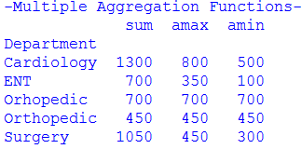

Slide 33
Transform
Transform is an operation used in conjunction with groupby (which is one of the most useful operations in pandas). We retain the same number of items as the original data set. That is the unique feature of using transform.
print("-Transform-")
df["Total Fee"] = df.groupby('Department')["Fee"].transform('sum')
print(df)

Slide 34
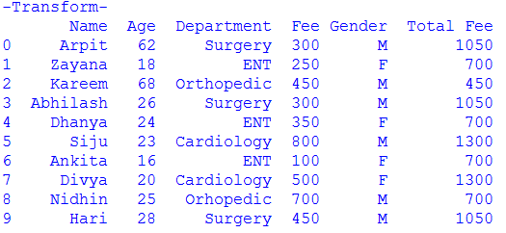

Slide 35
Pandas Series.transform() function Call function (the passed function) on self producing a Series with transformed values and that has the same axis length as self.

Slide 36
Transform – Ex. ( Increase the fee of each by 1000)
import pandas as pd
PData = {'Name' : ['Arpit','Zayana','Kareem','Abhilash','Dhanya','Siju','Ankita','Divya','Nidhin','Hari'],
'Age' : [62,18,68,26,24,23,16,20,25,28],
'Department' : ['Surgery','ENT','Orthopedic','Surgery','ENT','Cardiology','ENT','Cardiology','Orhopedic','Surgery'],
'Fee':[300,250,450,300,350,800,100,500,700,450],
'Gender':['M','F','M','M','F','M','F','F','M','M']
}
df = pd.DataFrame(PData)
print(df)
print("----------------Transform----------------")
df["Fee"] = df['Fee'].transform(lambda x : x + 1000)
print(df)

Slide 37
